Slide 1

Test Results

Slide 2
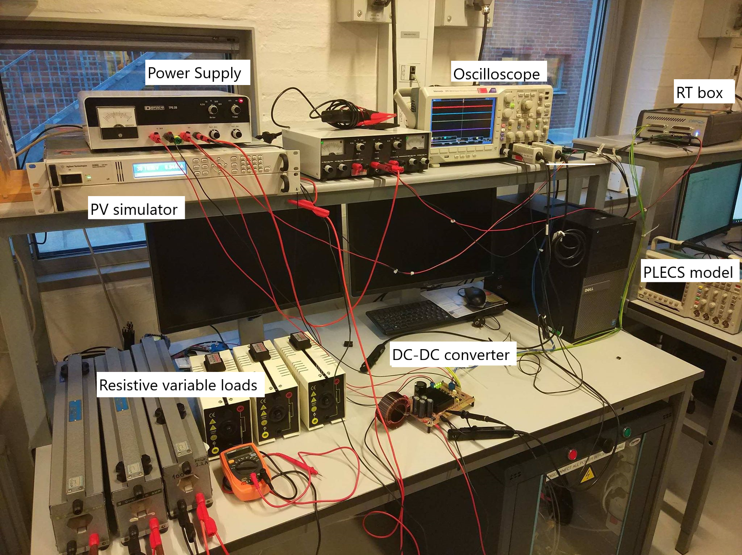
Test setup

Slide 3
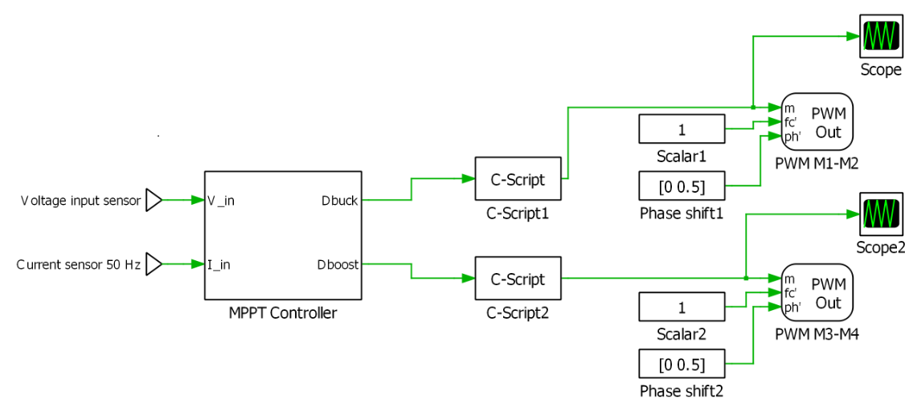
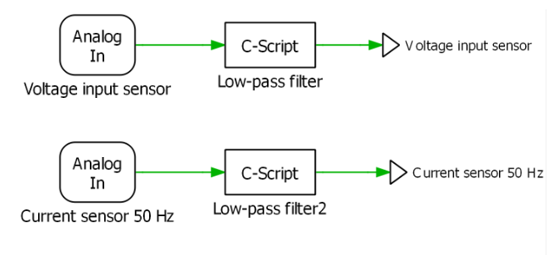
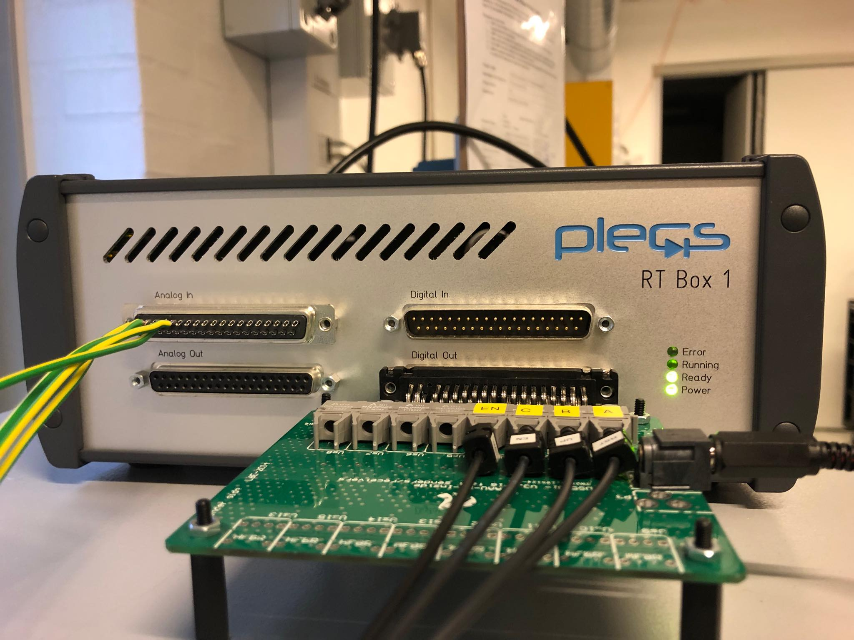
Test setup
RT Box:
PLECs model for interface with the RT Box.

Slide 4
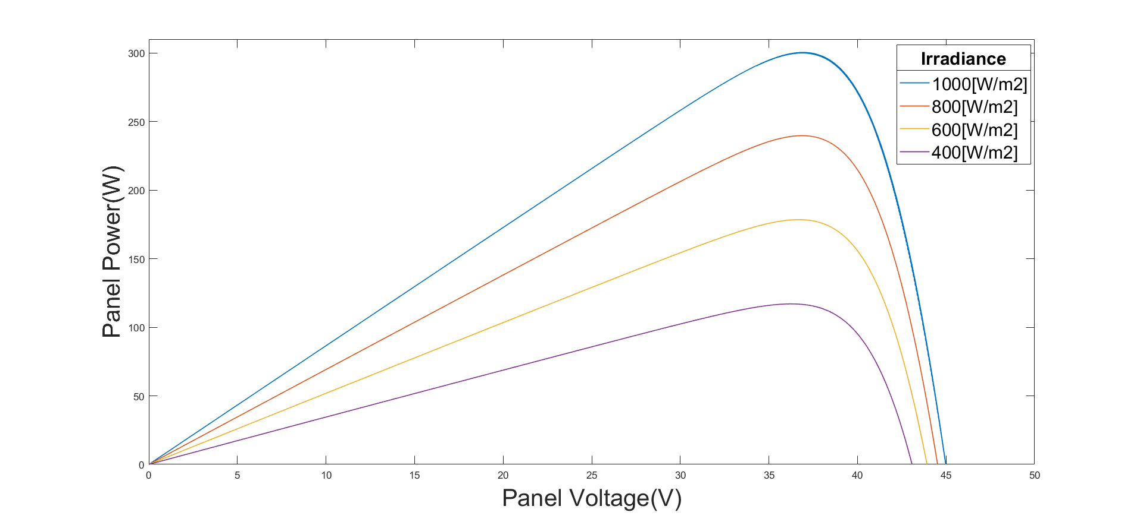
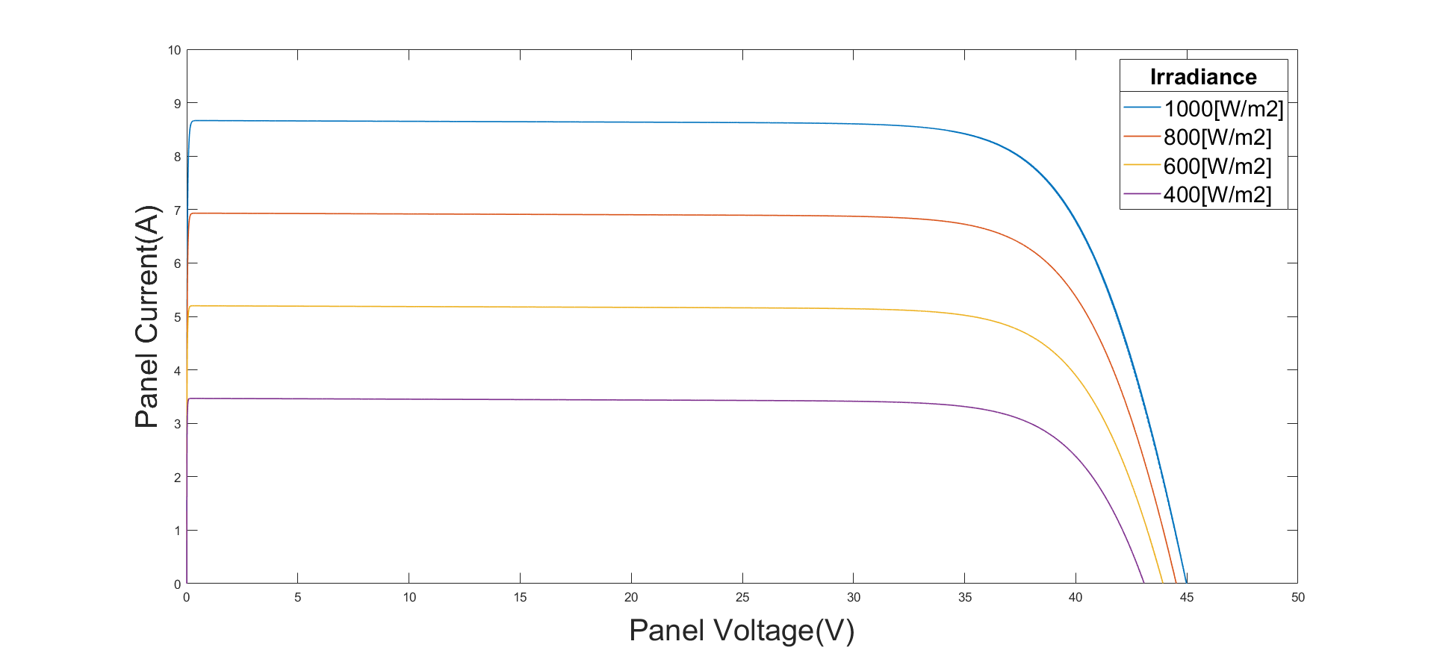

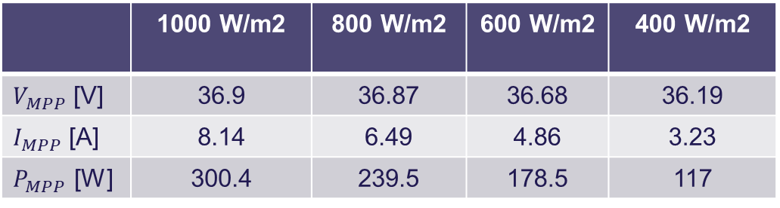
PV panel curves
$V_{MPP}=36.9 V$
$I_{MPP}=8.14 A$
$P_{MPP}=300.4 W$
Irradiance effect:
PV module datasheet (STC)
P-V curves for T=25ºC and varying irradiance.
I-V curves for T=25ºC and varying irradiance.
 | 1000 W/m2 | 800 W/m2 | 600 W/m2 | 400 W/m2
$V_{MPP}$ [V] | 36.9 | 36.87 | 36.68 | 36.19
$I_{MPP}$ [A] | 8.14 | 6.49 | 4.86 | 3.23
$P_{MPP}$ [W] | 300.4 | 239.5 | 178.5 | 117

Slide 5
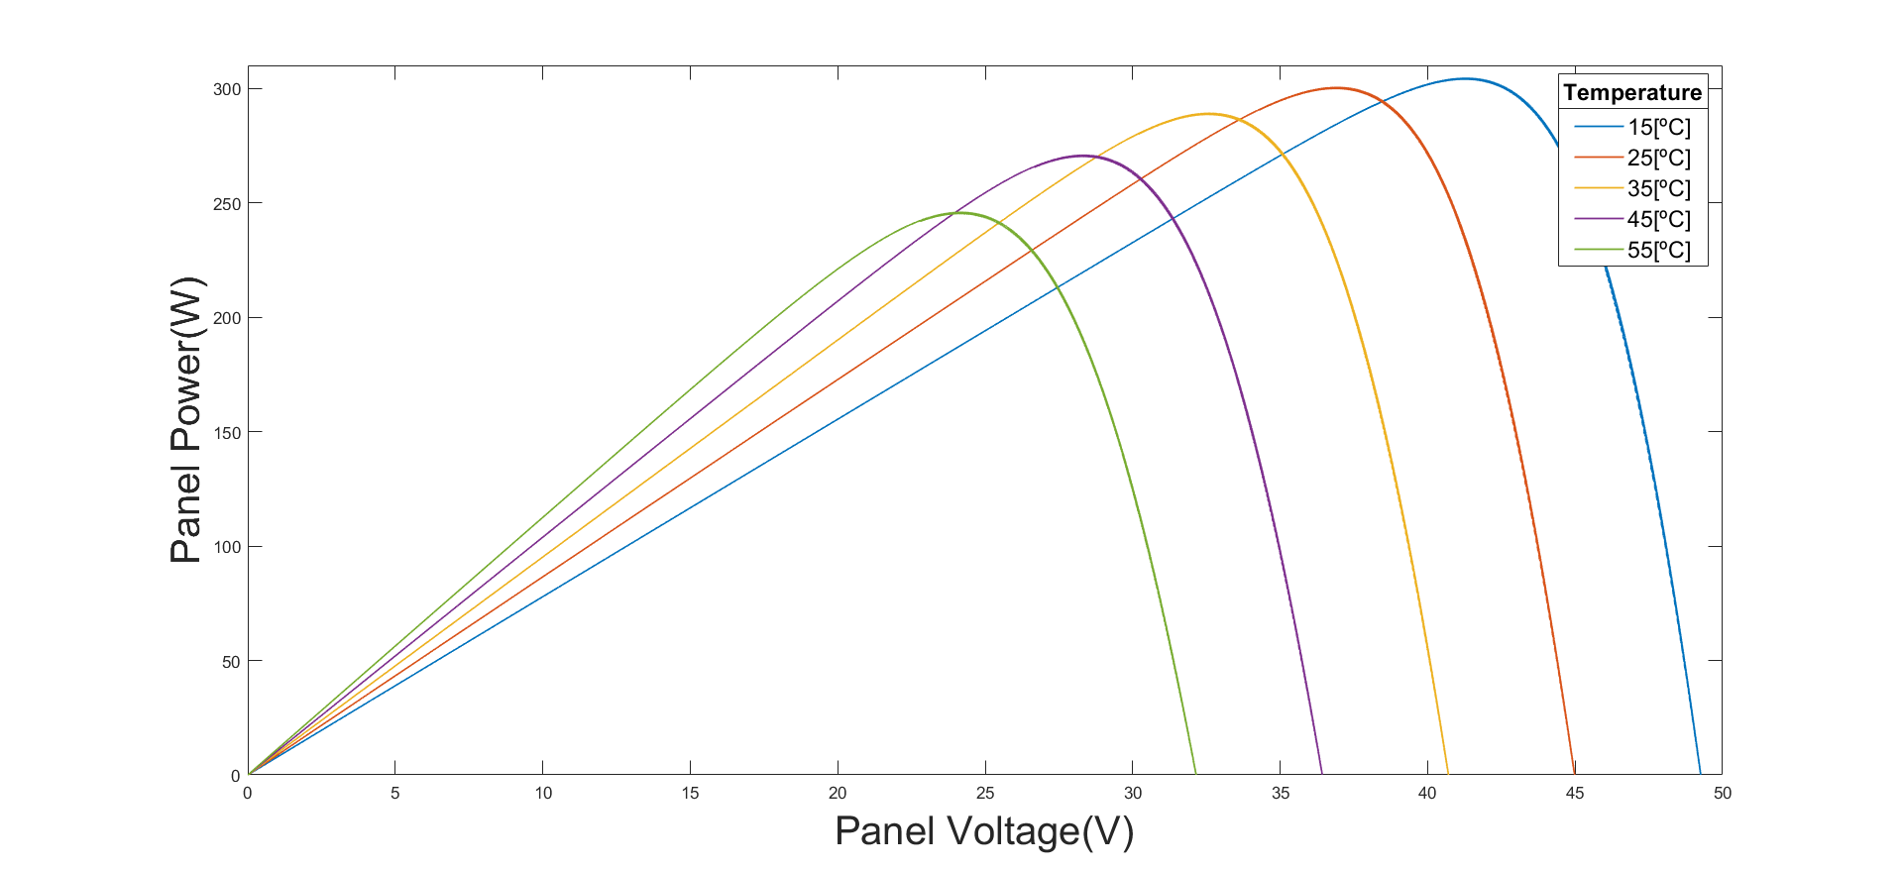
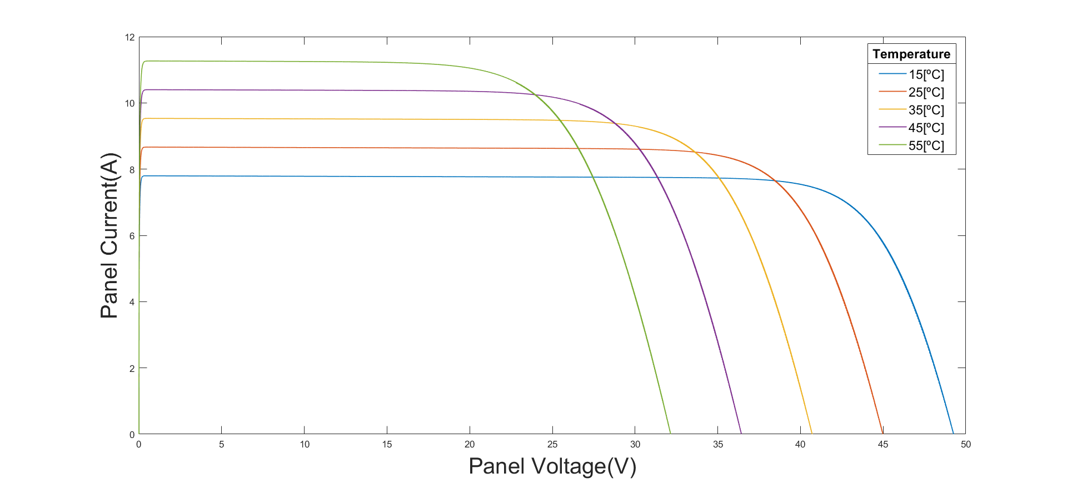
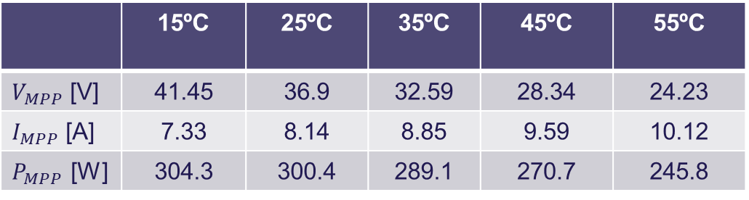
PV panel curves
Temperature effect:
P-V curves for 1000 W/m2 and varying temperature.
I-V curves for 1000 W/m2 and varying temperature.
 | 15ºC | 25ºC | 35ºC | 45ºC | 55ºC
$V_{MPP}$ [V] | 41.45 | 36.9 | 32.59 | 28.34 | 24.23
$I_{MPP}$ [A] | 7.33 | 8.14 | 8.85 | 9.59 | 10.12
$P_{MPP}$ [W] | 304.3 | 300.4 | 289.1 | 270.7 | 245.8

Slide 6
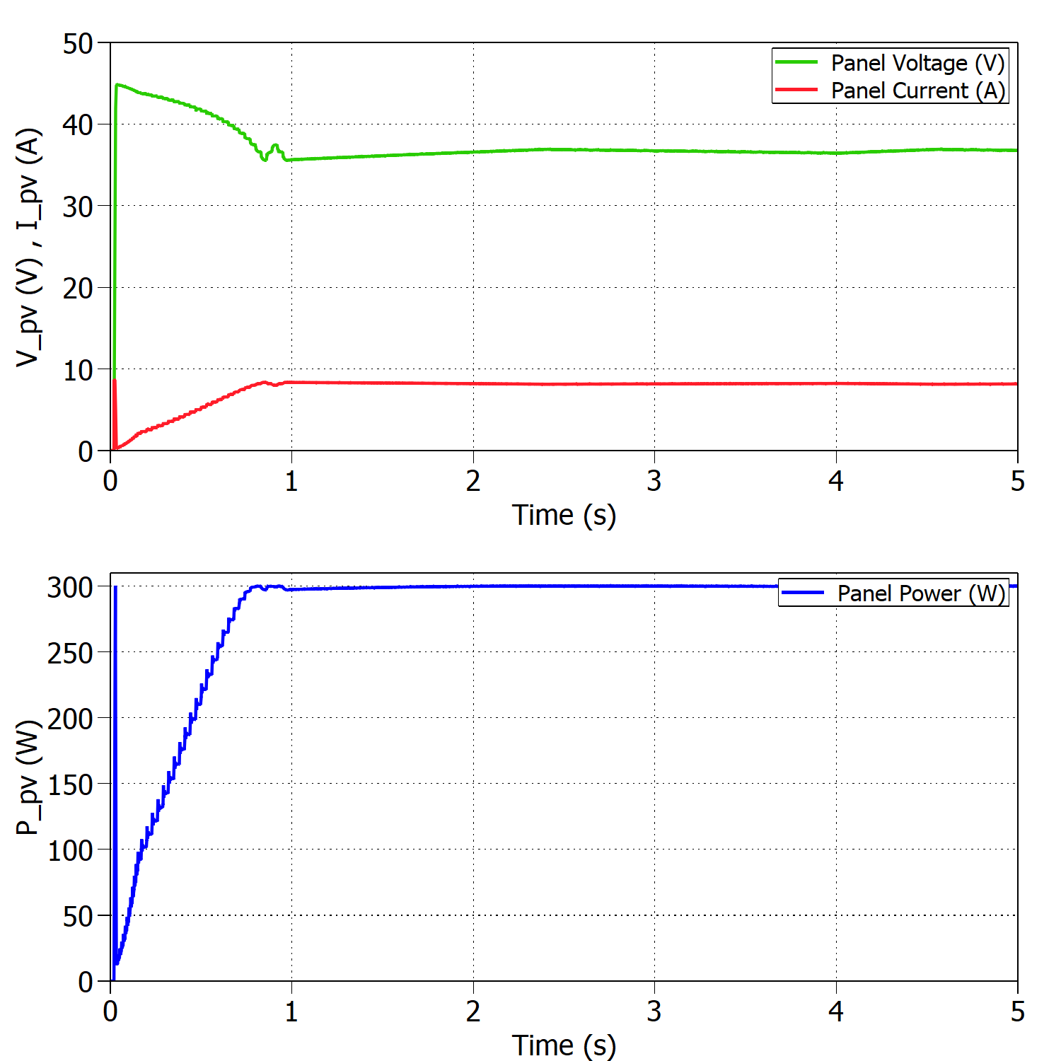
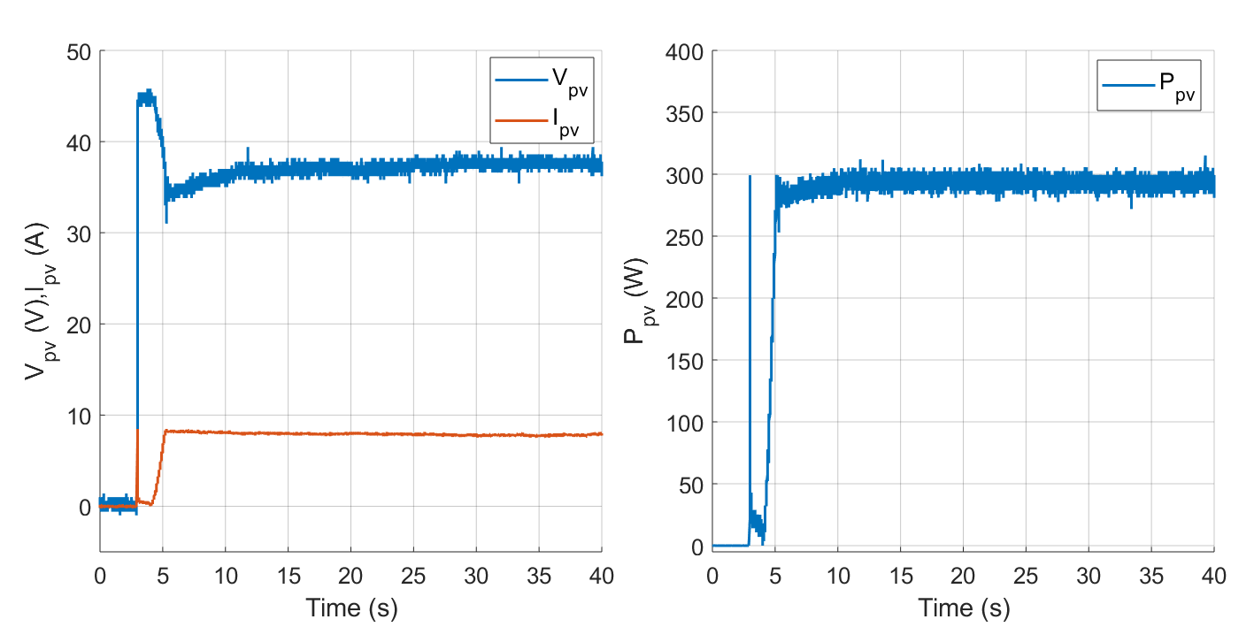




Standard Test Conditions (STC)
Buck mode:
Experimental results under STC with $V_{out}=30 V$.
$$η_{MPPTsim}=99.96\%$$
$$η_{MPPTexp}=97.72\%$$
Simulated results under STC with $V_{out}=30 V$.

Slide 7
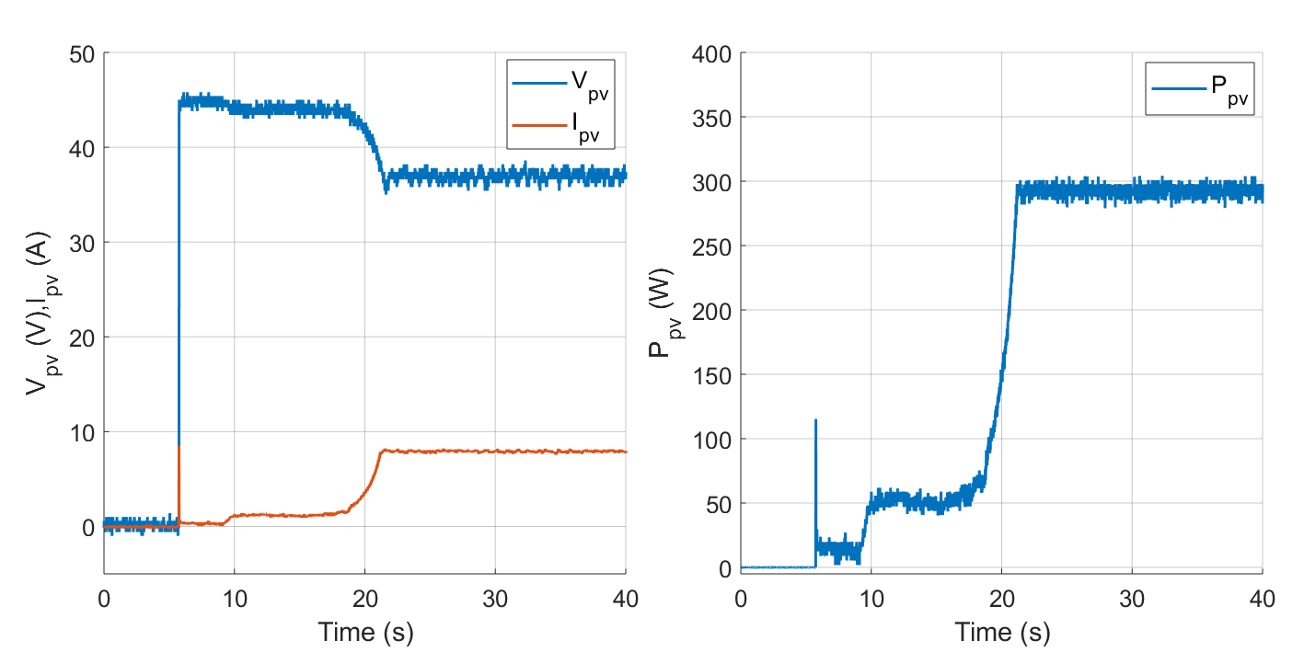
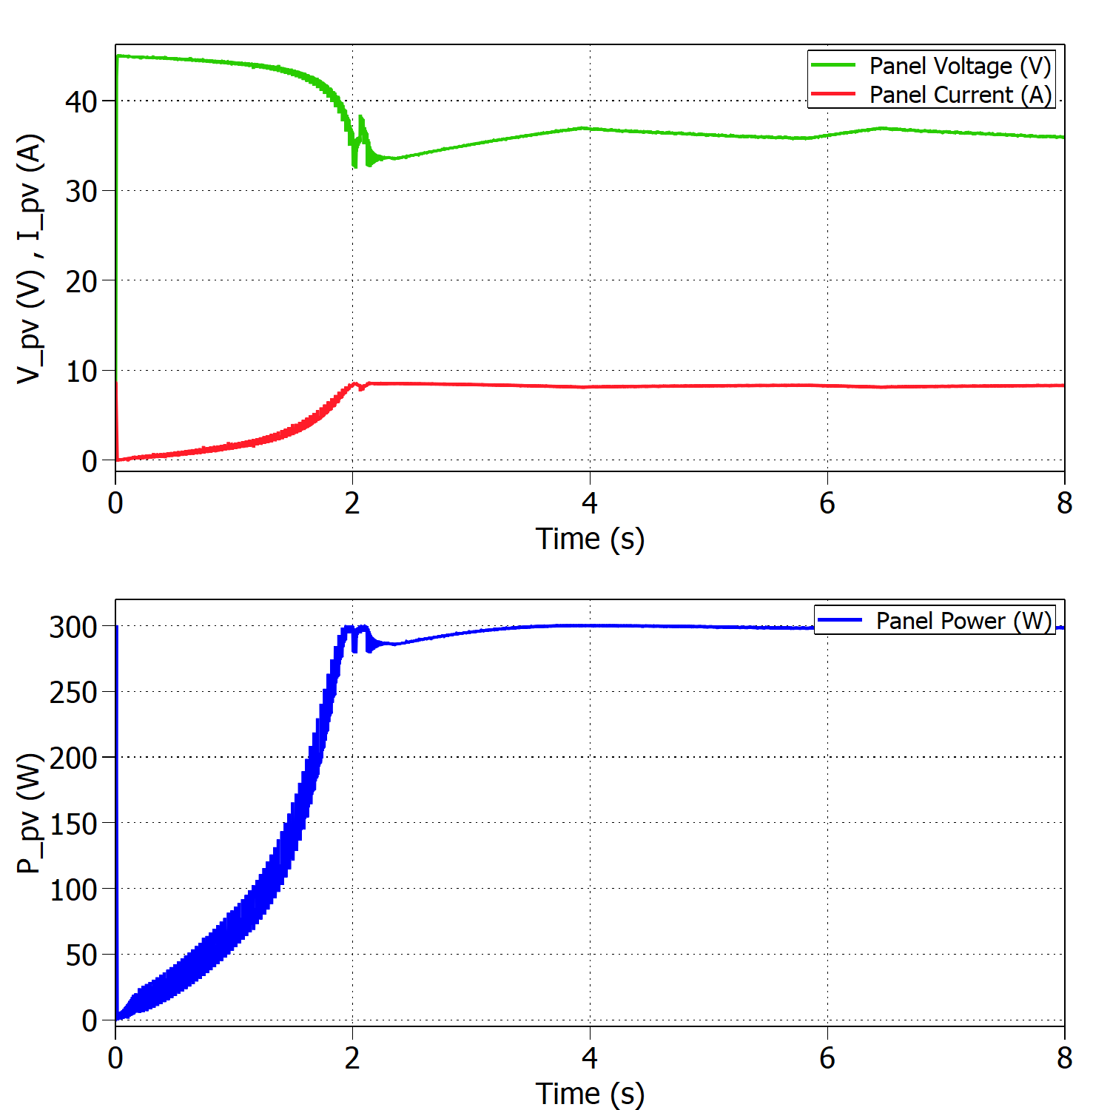




Standard Test Conditions (STC)
Boost mode:
Experimental results under STC ($V_{out}=90 V)$.
$$η_{MPPTsim}=99.82\%$$
$$η_{MPPTexp}=97.32\%$$
Simulated results under STC ($V_{out}=90 V)$.

Slide 8
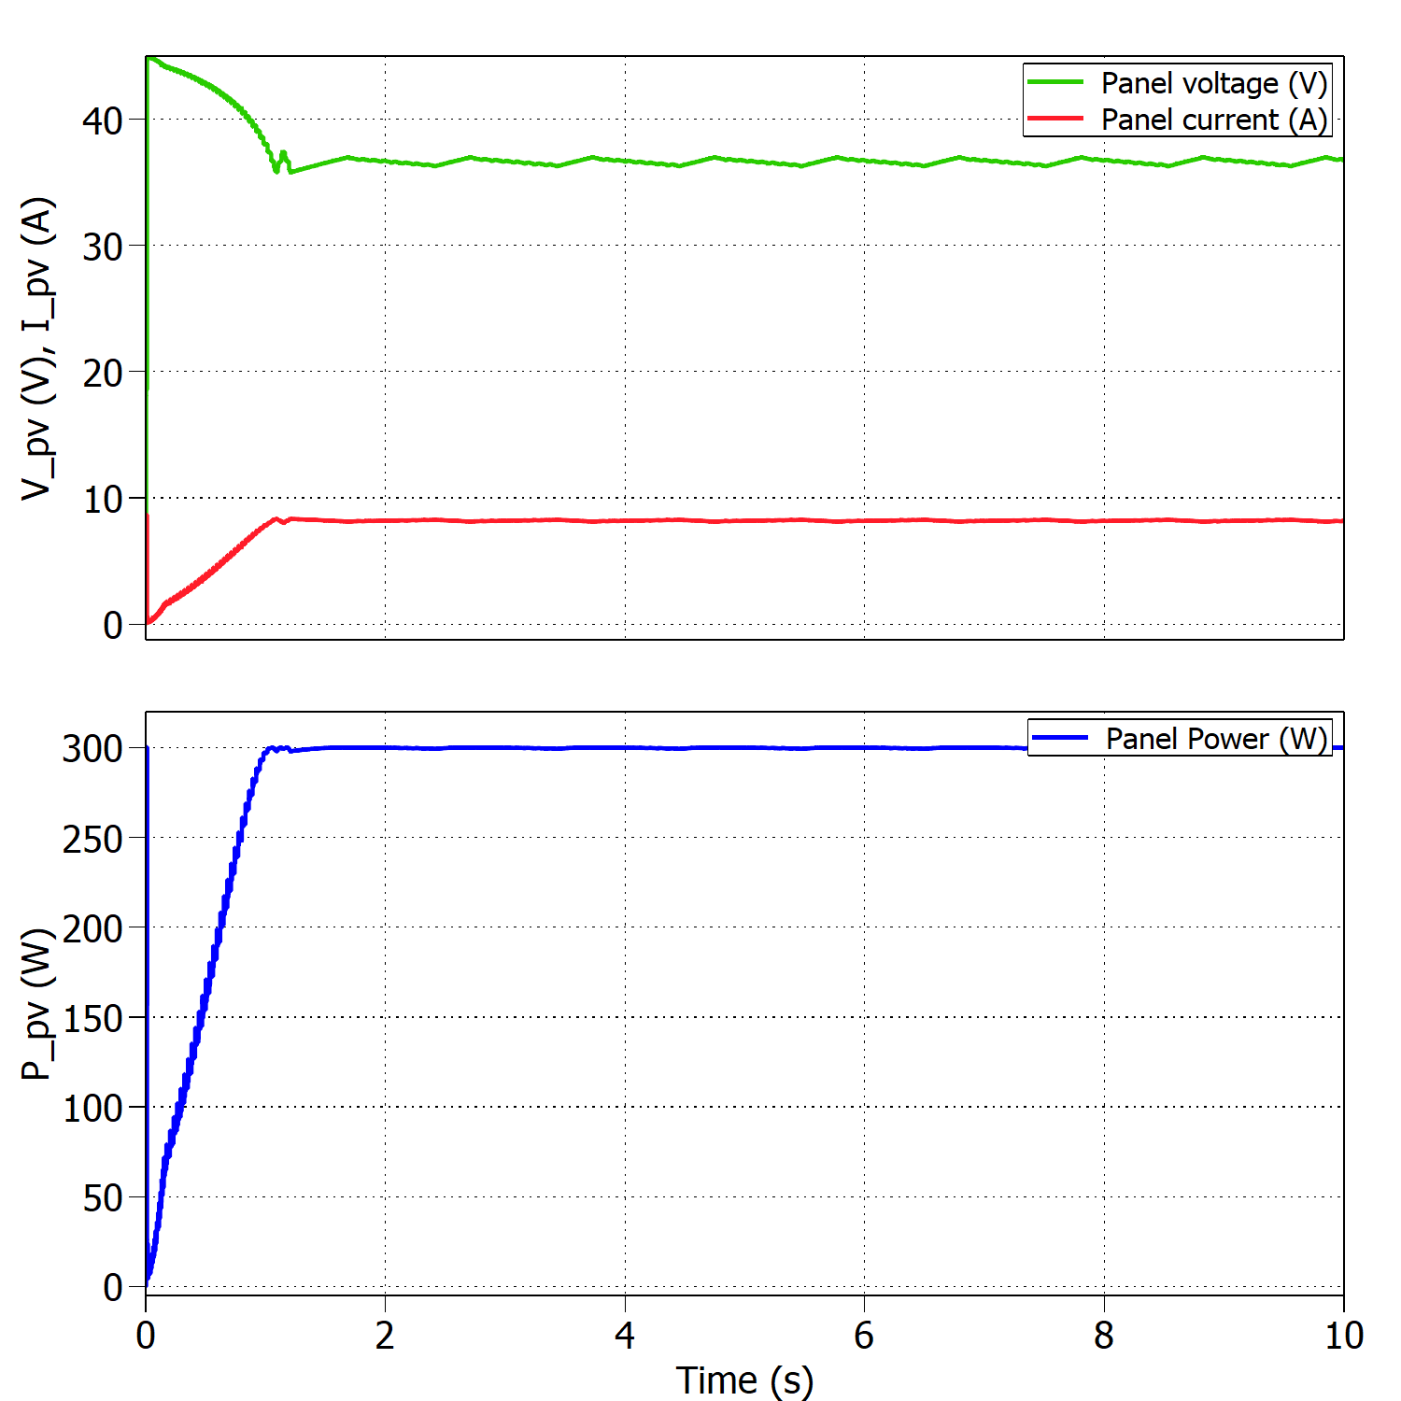
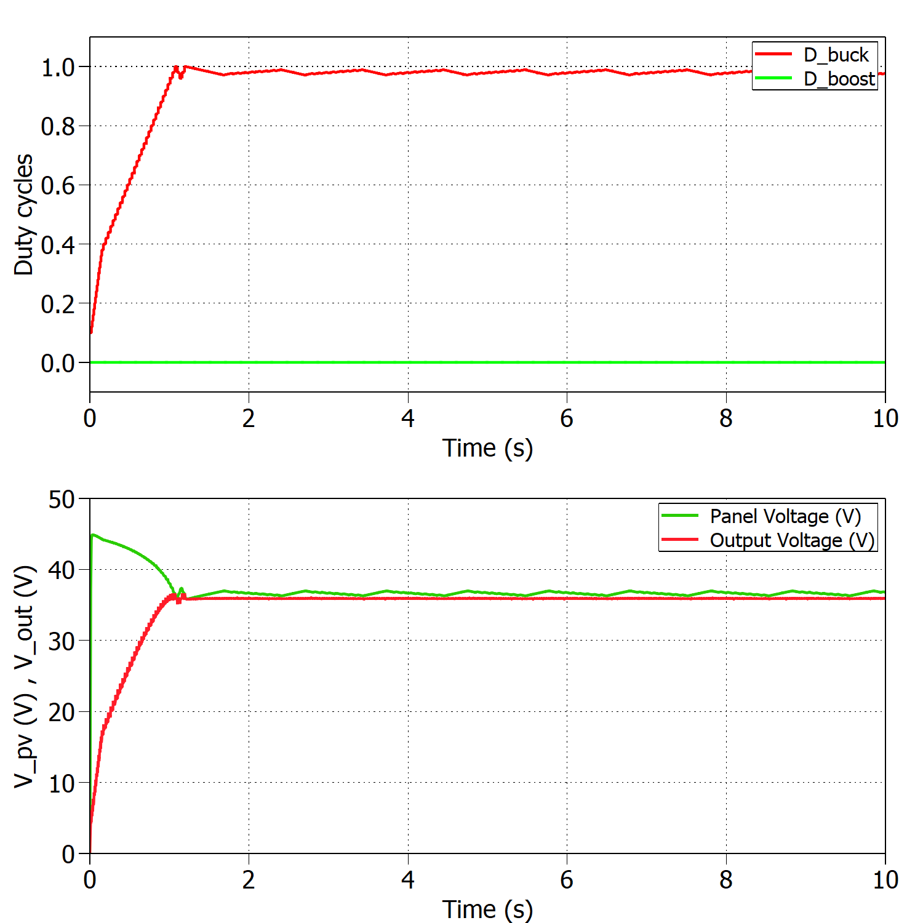

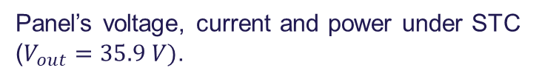
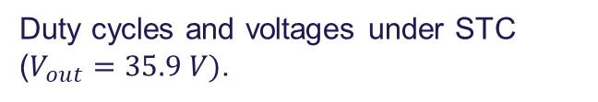
Boundary between modes of operation
Buck mode:
10 panels
$$η_{MPPT}=99.75\%$$
If T>25ºC → Boost
Panel’s voltage, current and power under STC ($V_{out}=35.9 V)$.
Duty cycles and voltages under STC ($V_{out}=35.9 V)$.

Slide 9
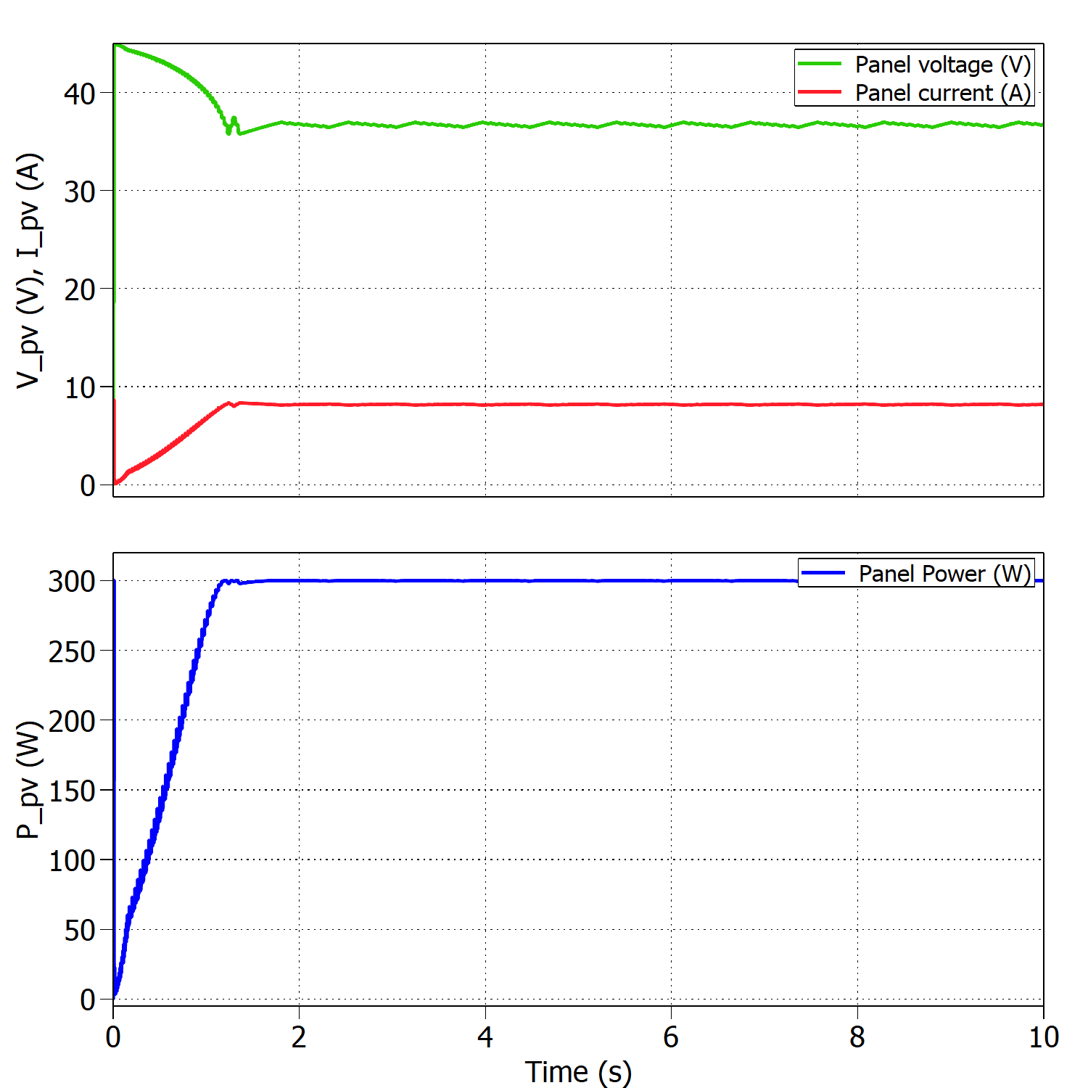
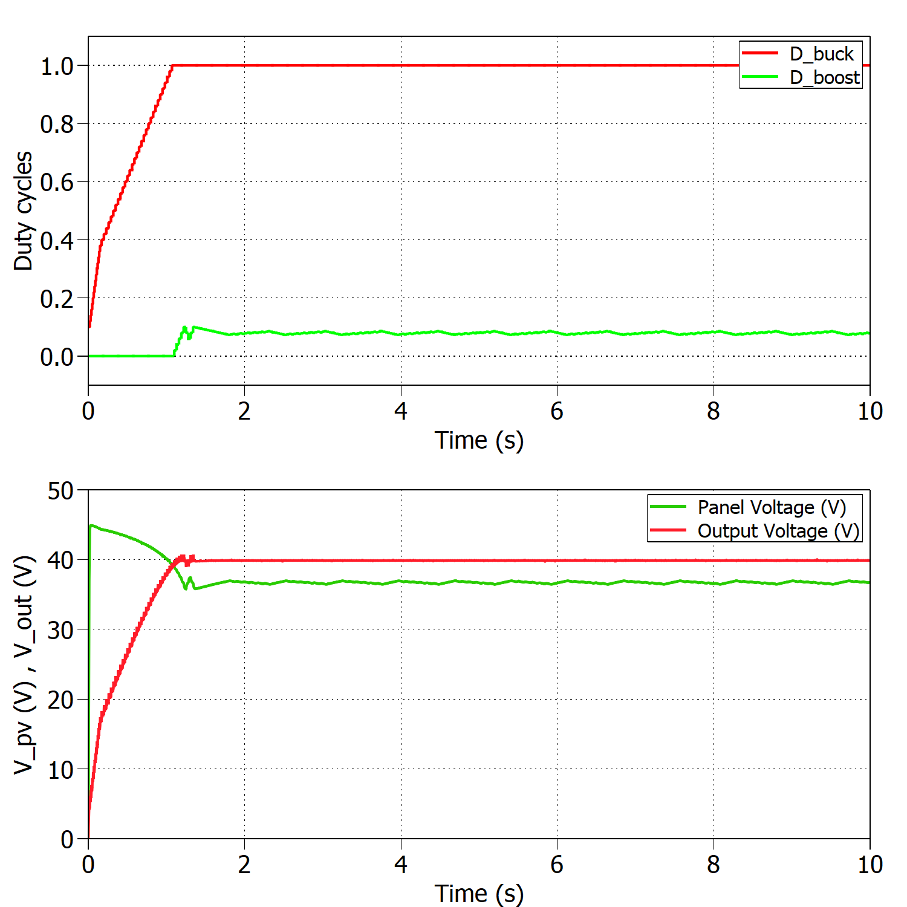

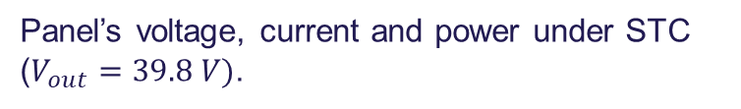
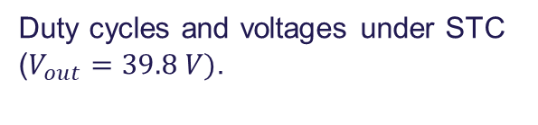
Boundary between modes of operation
Boost mode:
9 panels
$$η_{MPPT}=99.80\%$$
If T<25ºC → Buck
Panel’s voltage, current and power under STC ($V_{out}=39.8 V)$.
Duty cycles and voltages under STC ($V_{out}=39.8 V)$.

Slide 10
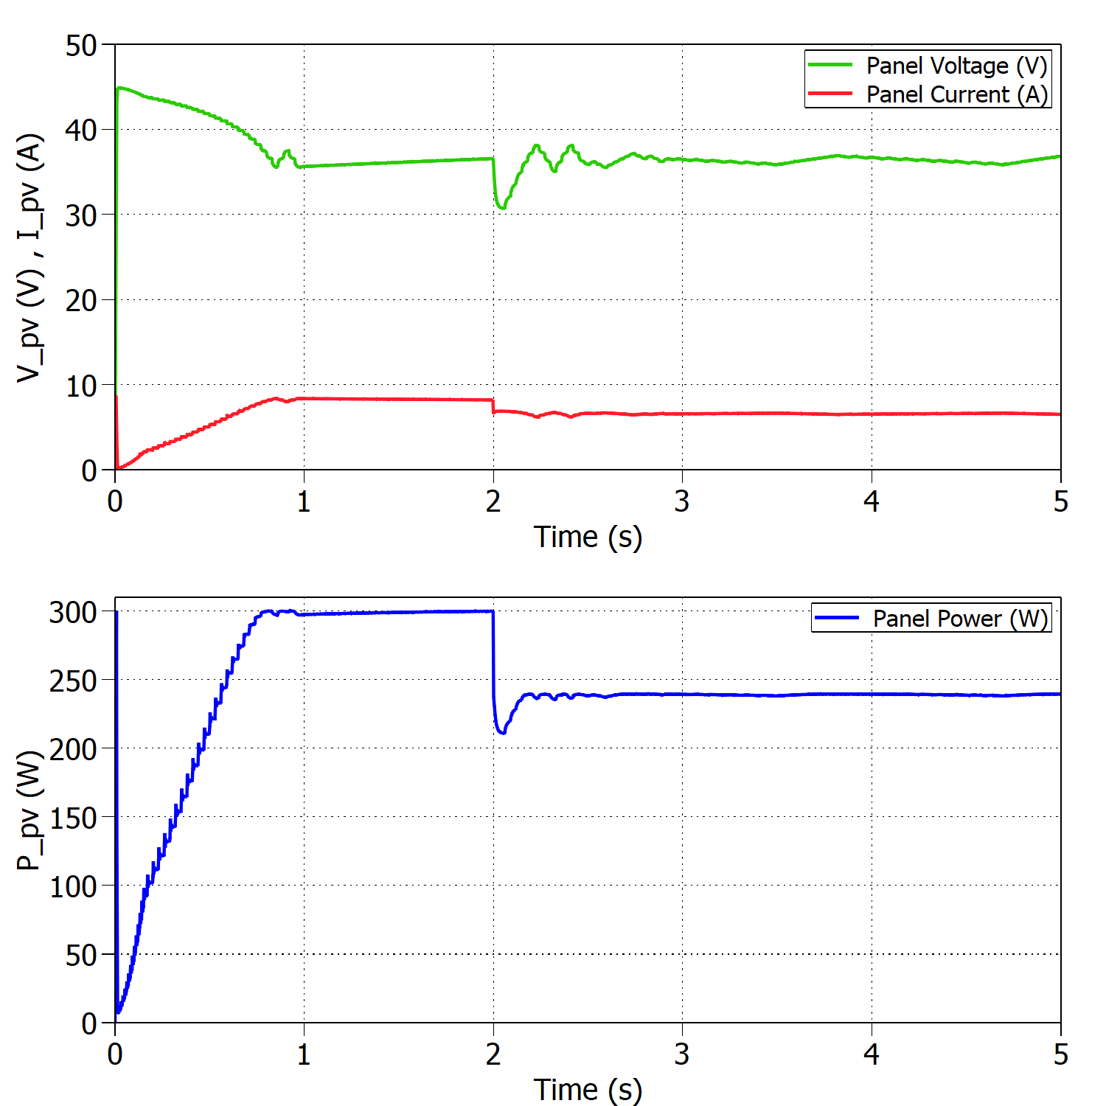
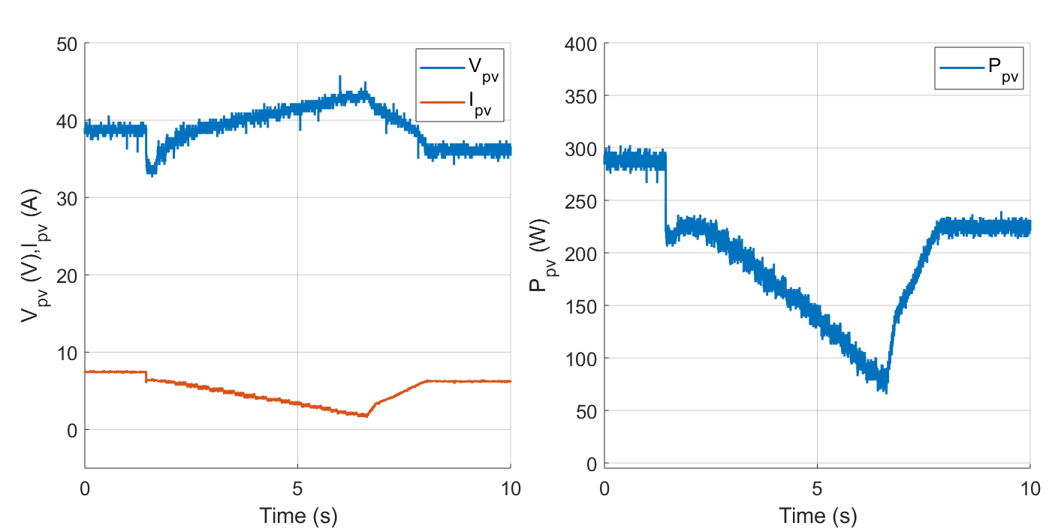


Sudden change in irradiance
Buck mode:
Experimental results for 1000 - 800 W/m2 and constant temperature T=25ºC.
Simulated results for 1000 - 800 W/m2 and constant temperature T=25ºC.
$$η_{MPPTsim}=99.70\%$$
$$η_{MPPTexp}=93.78\%$$

Slide 11
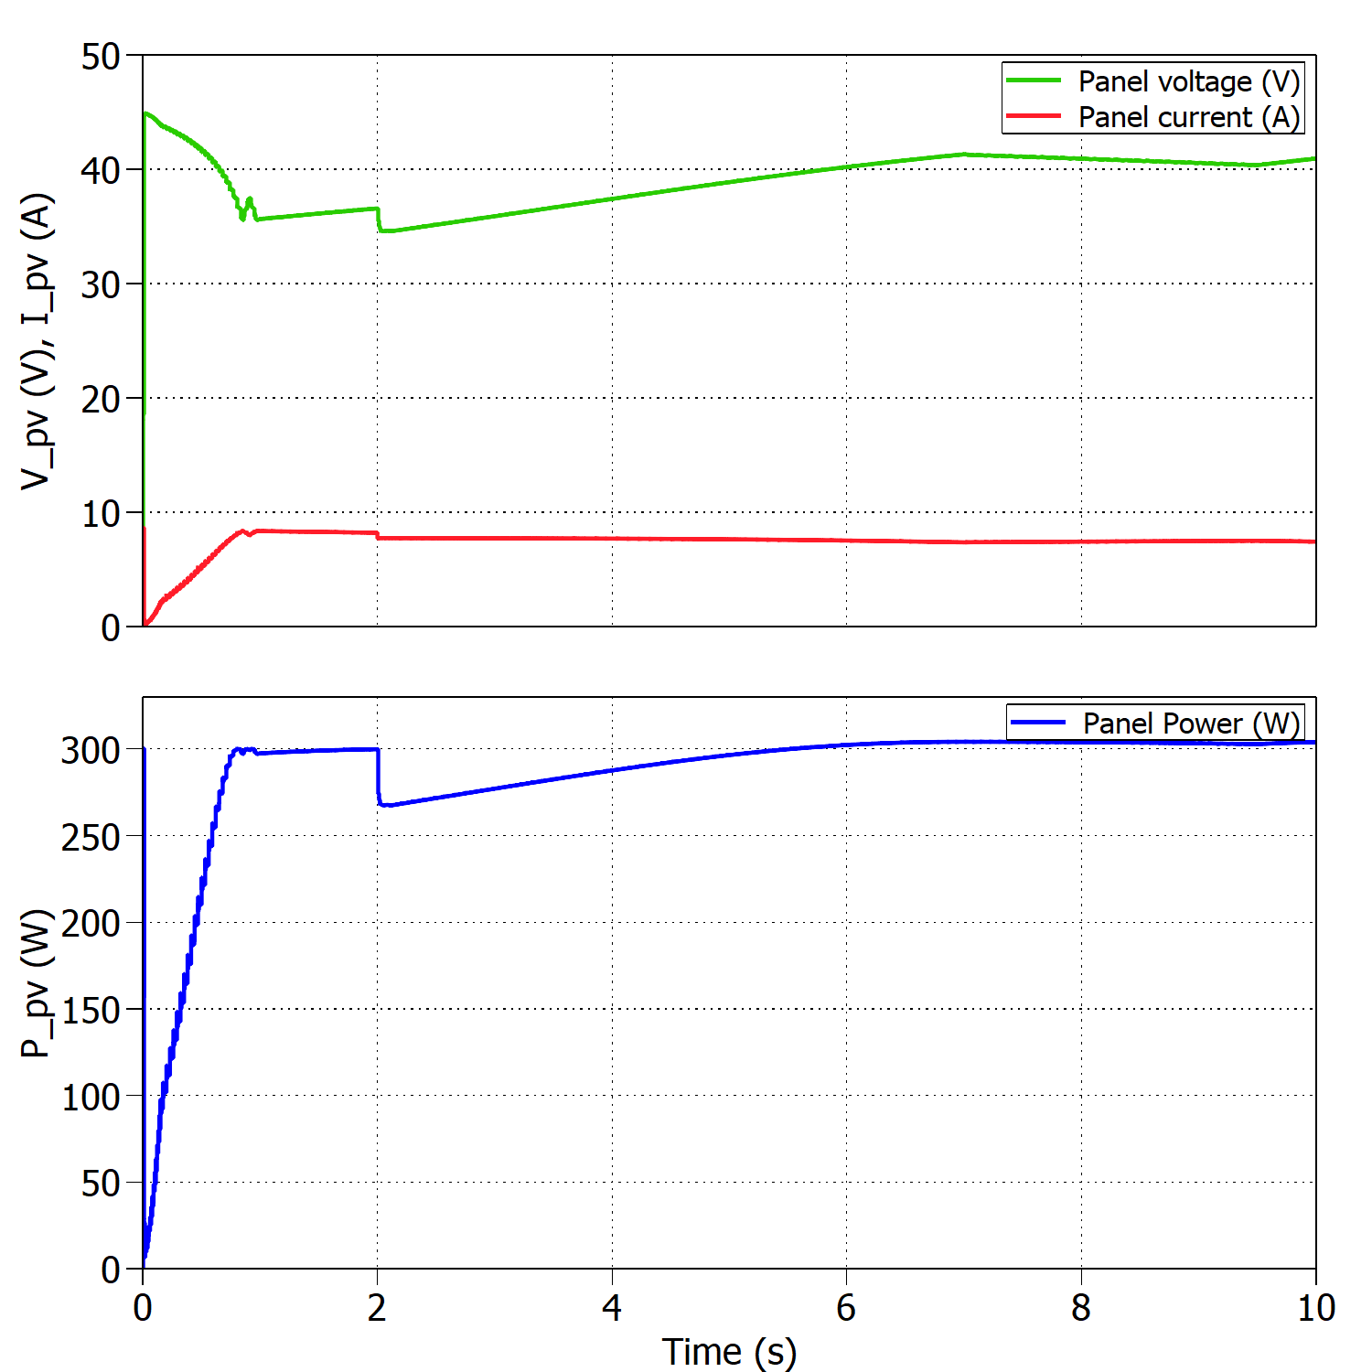
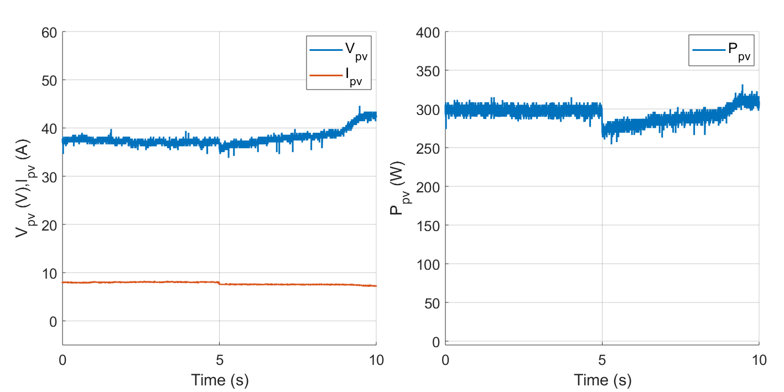


Sudden change in temperature
Buck mode:
Experimental results for 25 - 15 ºC and constant irradiance 1000 W/m2.
$$η_{MPPTsim}=99.90\%$$
$$η_{MPPTexp}=98.40\%$$
Simulated results for 25 - 15 ºC and constant irradiance 1000 W/m2.

Slide 12
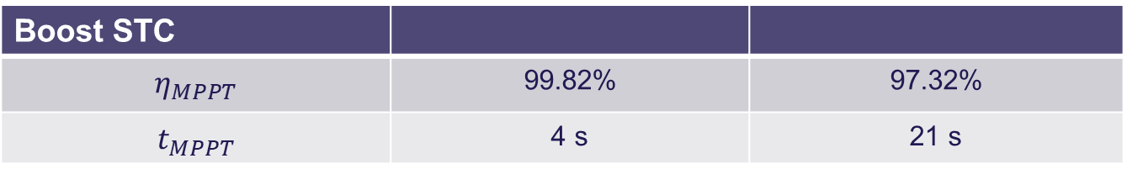



Comparison simulation and experiments
Buck STC | Simulation | Experiment
$$η_{MPPT}$$ | 99.96% | 97.72%
$$t_{MPPT}$$ | 2 s | 10 s
Boost STC
$$η_{MPPT}$$ | 99.82% | 97.32%
$$t_{MPPT}$$ | 4 s | 21 s
Buck 1000 - 800 W/m2
$$η_{MPPT}$$ | From 99.81% to 99.70% | From 95.96% to 93.78%
$$t_{MPPT}$$ | 0.5 s | 6.6 s
Buck 25 - 15 ºC
$$η_{MPPT}$$ | From 99.81% to 99.90% | From 99.20% to 98.40%
$$t_{MPPT}$$ | 2 s | 4.1 s

Slide 13
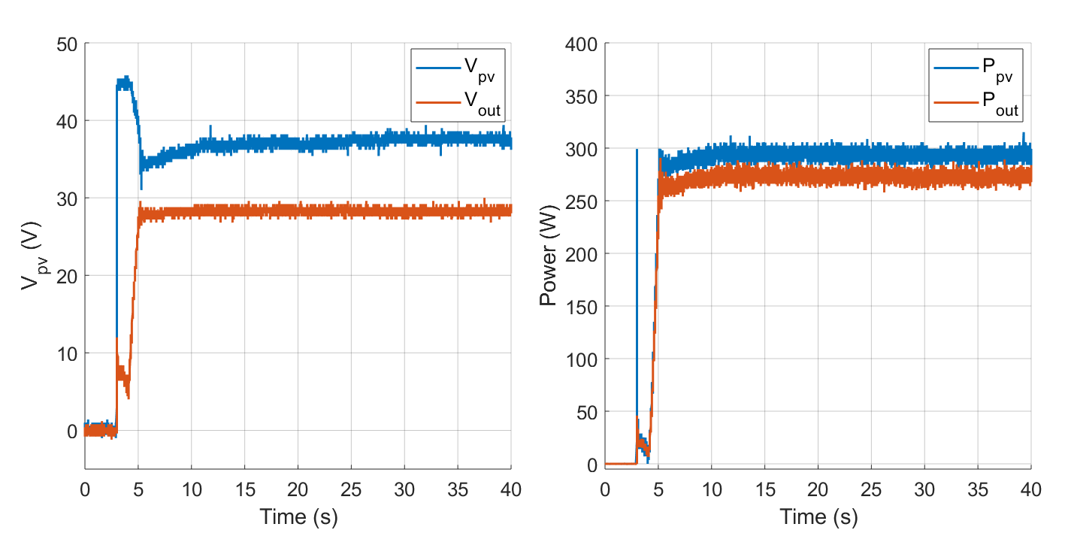

Efficiency of the converter
Buck mode:
Voltages and powers at the converter’s input and output under STC.
$$η_{converter}=\frac{P_{out}}{P_{PV}} ∗100=93.15\%$$

Slide 14
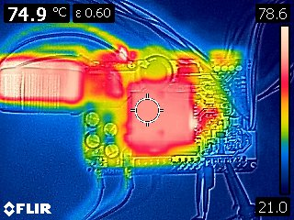
Thermal test
Open-loop buck mode:
Inductor and heat sink temperature varying with time.
Thermal camera showing hot and cold spots in the PCB.

Slide 15

Thank you for your attention
Questions?

